Slide 1
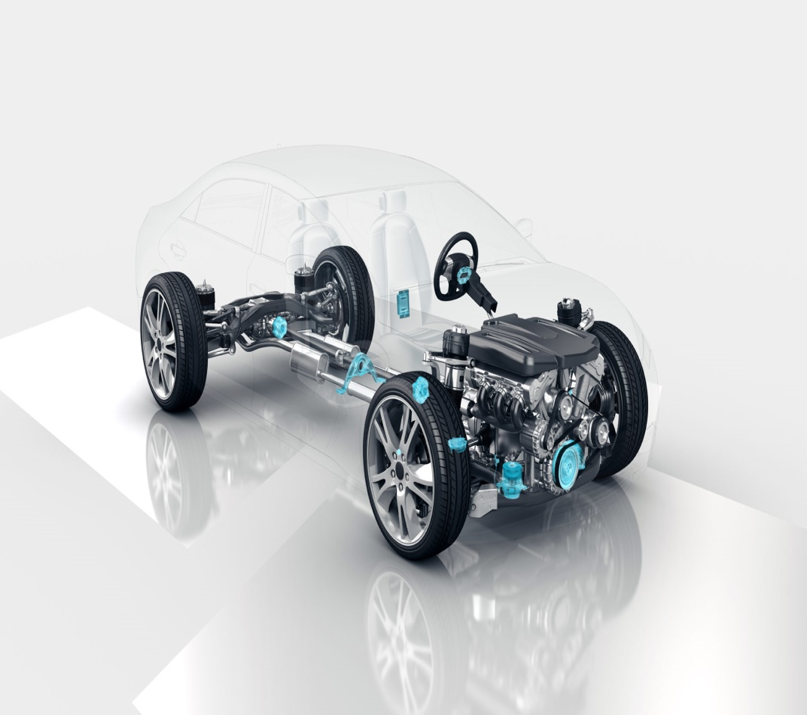

School of Electronics and Communication Engineering
Automotive Electronics
(17EECC305)
Faculty:
Prabha C. Nissimagoudar
Associate Professor, School of ECE,
KLETECH, Hubballi.

Slide 2
School of Electronics and Communication Engineering
Course Outcomes (COs):
At the end of the course the student should be able to:
Acquire an overview of automotive components, subsystems, design cycles, communication protocols and safety systems employed in today's automotive industry.
Determine the role of electronics for the areas like In-vehicle architectures, networking, engine management systems, vehicle safety systems & infotainment systems.
Select, Classify and interface sensors to automotive systems.
Establish the need of vehicle safety standards and diagnostics systems in the automotive industry and implications on OEMs, Suppliers and Customers.
Design and implement an automotive sub system to realize Electronic Control Unit.

Slide 3
School of Electronics and Communication Engineering
What is Automotive electronics?
Automotive electronics are the electronics used in automobiles either to replace the existing mechanical component or/and control.

Slide 4
Why do we need electronics in Automotives?
School of Electronics and Communication Engineering
Fuel efficiency
Exhaust particle
Control the temp inside engine
High power
Higher torque
Control knocking
ECM

Slide 5
Why do we need electronics in Automotives?
School of Electronics and Communication Engineering
Vehicle slip control
Over steering control
Under steering control
Vehicle roll over control
Reduce stopping distance
Brake distribution
ABS,TCS
and ESP
Vehicle interior lighting
Vehicle exterior lighting
Automatic Door lock
Power windows
Remote key
BCM

Slide 6
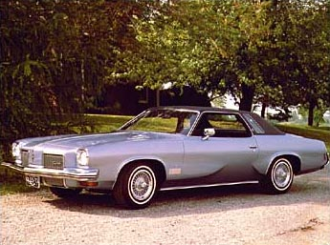
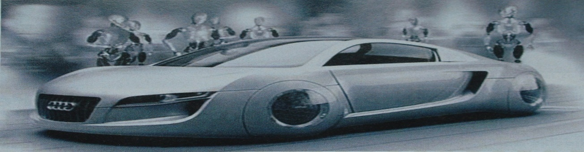

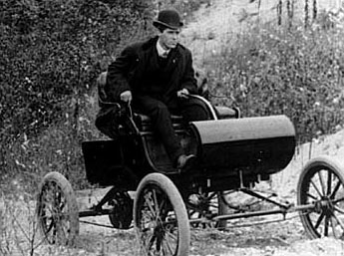
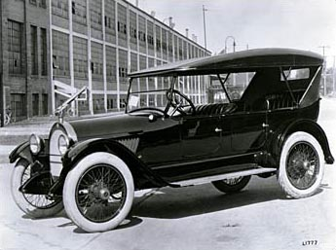
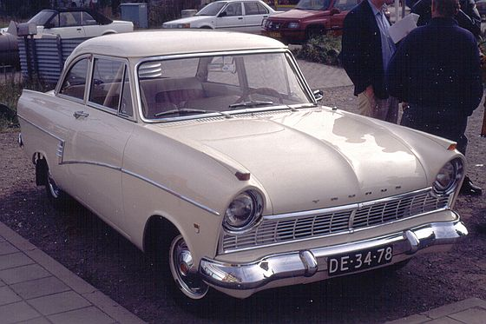
Trends in automotive Vehicles
School of Electronics and Communication Engineering
CAR Technology TRAFFIC DRIVER SKILLS
> 1891 mechanical system very low very high technical skills
> 1920 + pneumatic systems low high technical skills + hydraulic systems low driving skills
> 1950 + electric systems increasing good technical skills increasing driving skills
> 1980 + electronic systems congestion low technical skills + optronic systems starts high driving skills
> 2010 + nanoelectronics congested very low technical skills + biotronic systems optimization decreasing driving skills starts
> 2040 + robotics maximal and no technical skills + nanotechnology optimized no driving skills

Slide 7
School of Electronics and Communication Engineering
Phase 1: Introduction of Electronics in non-critical applications
Driver information and entertainment e.g. radio
Comfort and convenience e.g. electric windows, wiper/washer, seat heating, central locking, interior light control …
➔ Low intelligence electronic systems
➔ Minor communication between systems (pushbutton control)
➔ No impact on engine performance
➔ No impact on driving & driver skills

Slide 8
School of Electronics and Communication Engineering
Phase 2: Electronics support critical applications
Engine optimization e.g. efficiency improvement & pollution control
Active and Passive Safety e.g. ABS, ESP, airbags, tire pressure, Xenon lamps …
Driver information and entertainment e.g. radio-CD-GPS, parking radar, service warnings …
Comfort, convenience and security e.g. cruise control, keyless entry, transponders …
➔ Increasingly complex and intelligent electronic systems
➔ Communication between electronic systems within the car
➔ Full control of engine performance
➔ No control of driving & driver skills But reactive correction of driver errors.
➔ Electronics impact remains within the car

Slide 9
School of Electronics and Communication Engineering
Phase 3: Electronics control critical applications
Full Engine control e.g. start/stop cycles, hybrid vehicles …
Active and Passive Safety e.g. X by wire, anti-collision radar, dead-angle radar …
Driver information and entertainment e.g. traffic congestion warning, weather and road conditions …
Comfort and convenience
➔ Very intelligent and robust electronics
➔ Communication between internal and external systems Information exchange with traffic network
➔ Full control of engine performance
➔ Control of driving and (decreasing) driving skills Proactive prevention of dangerous situations inside and around the car
➔ Full control of car and immediate surroundings

Slide 10
School of Electronics and Communication Engineering
Phase 4: Fully Automatic Driver (1st generation)
➔ Traffic network takes control of the macro movements (upper layers) of the car
Automatic Driver executes control of the car and immediate surroundings (lower and physical layers)
Driver has become the Passenger for the complete or at least for most of the journey

Slide 11
Automotive Electronics System View
School of Electronics and Communication Engineering
http://www.cvel.clemson.edu/auto/systems/auto-systems.html

Slide 12
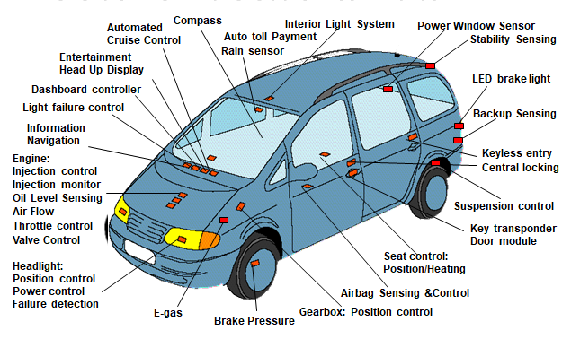
School of Electronics and Communication Engineering
Where do we find electronics in a car

Slide 13
automotive industry domain structure
School of Electronics and Communication Engineering
Automotive Electrical and Electronic systems are divided into clusters of related functions
Infotainment
Body electronics
Chassis and driver assistance
Safety Systems
Powertrain

Slide 14
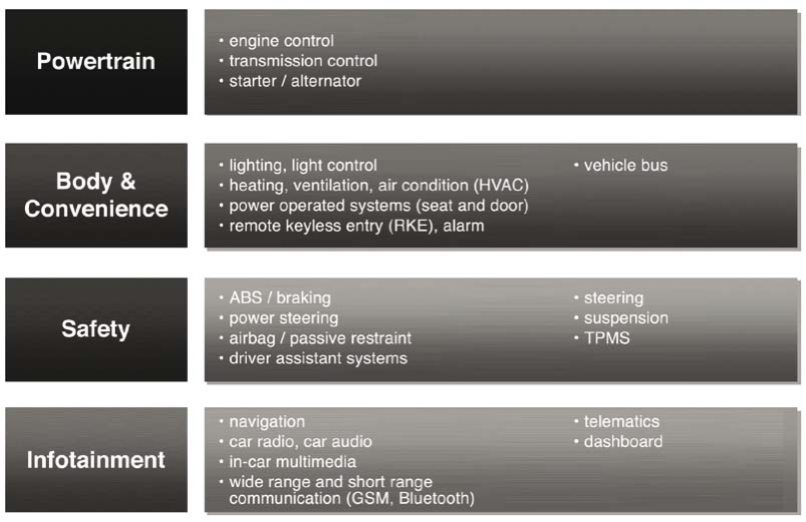
Electronics controls used in various car systems today
School of Electronics and Communication Engineering

Slide 15
School of Electronics and Communication Engineering
Overview & Organization of Automotive
Industry Industry

Slide 16
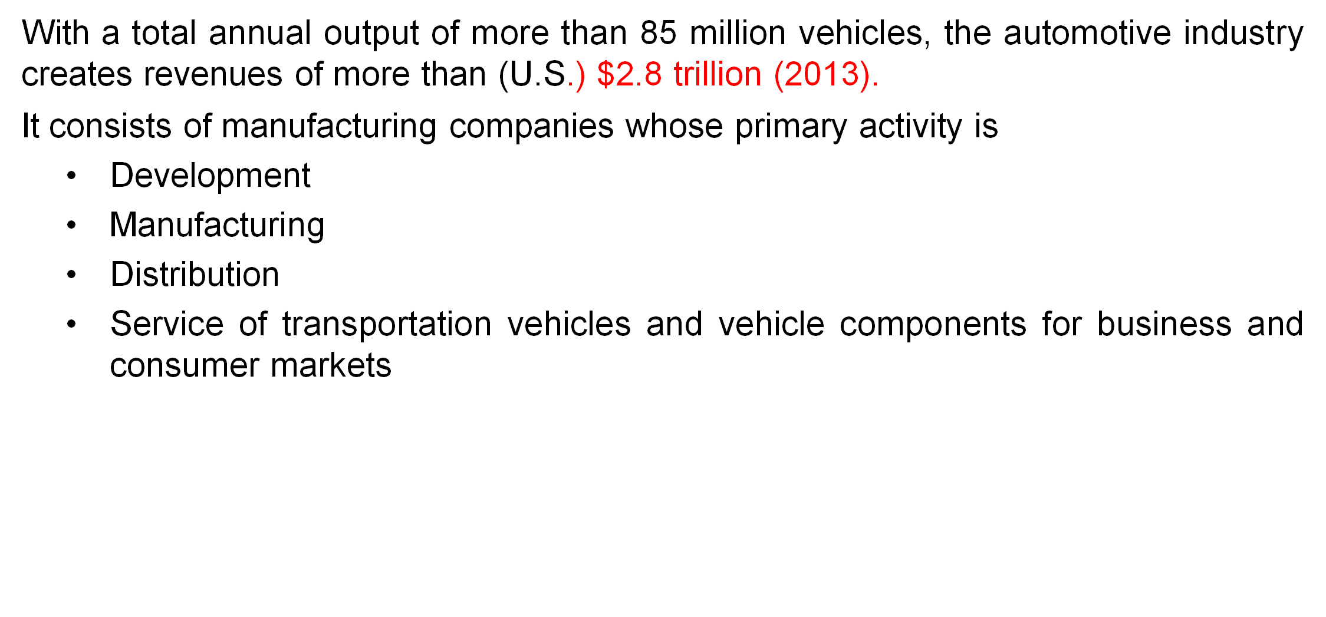
School of Electronics and Communication Engineering
Automotive Industry Size

Slide 17
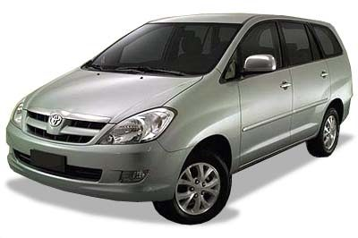
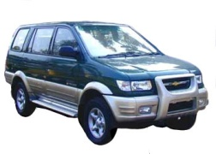
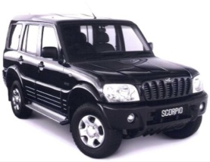
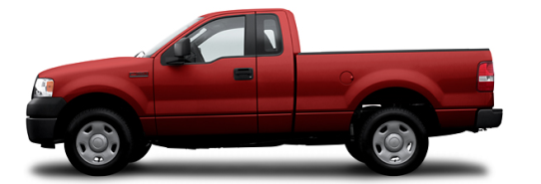
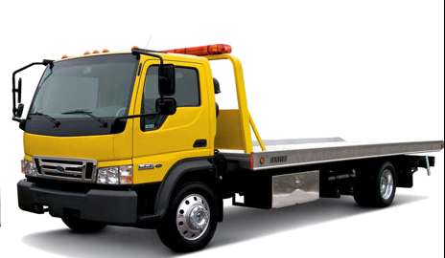
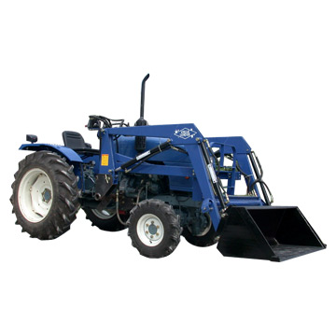
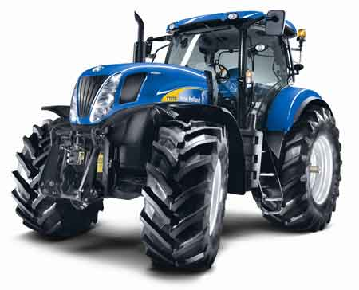
School of Electronics and Communication Engineering
Product Categories
Cars,
Passenger cars
vans,
SUV, MAV,…
Products may be categorized under
Light trucks
Motorbikes
Heavy trucks
Agriculture vehicles
Construction vehicles
Military vehicles
Players include
OEMs like GM, Ford, BMW, DC, Nissan, Renault,
Peugeot, Volkswagen, Volvo, Honda, Toyota
a large number of Tiered suppliers like JCI, Lear,
Visteon, Delphi etc
vendors (Ex. Engine manufactures)
service providers (insurance, dealers, parts,
finance, system, certification)
Customers

Slide 18
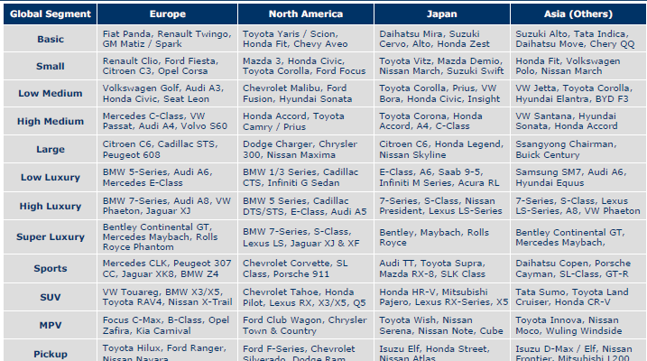
School of Electronics and Communication Engineering
Vehicle Segment Examples

Slide 19
School of Electronics and Communication Engineering
Segmenting the Auto Industry
The Industry can be classified into four sub-segments:
OEMs: The makers of cars, light trucks, and motorbikes
Heavy equipment: The makers of heavy trucks, buses, and construction, agricultural, and military vehicles
Suppliers: The suppliers of material, parts, components, engineering services, and systems to the OEMs
Dealers: The wholesale and retail distributors and importers of vehicles
The total money spent by the automotive industry on IT is about (U.S.) $37 billion (2013)

Slide 20
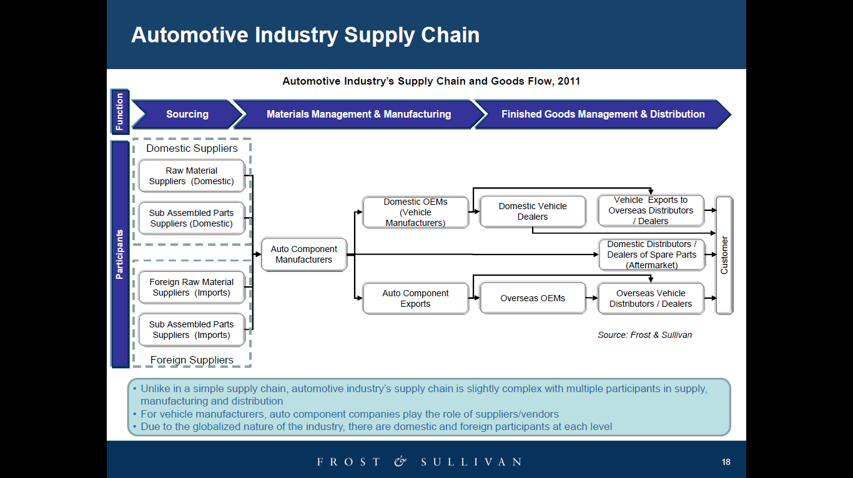
School of Electronics and Communication Engineering
Automotive Supply Chain

Slide 21
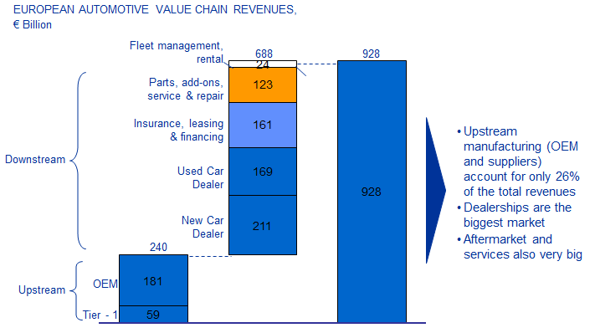
School of Electronics and Communication Engineering
A majority of the Auto industry revenue is in the downstream

Slide 22
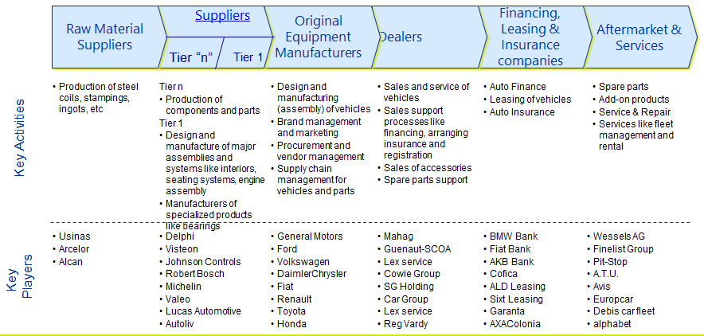
School of Electronics and Communication Engineering
A drill down view into the automotive value chain

Slide 23
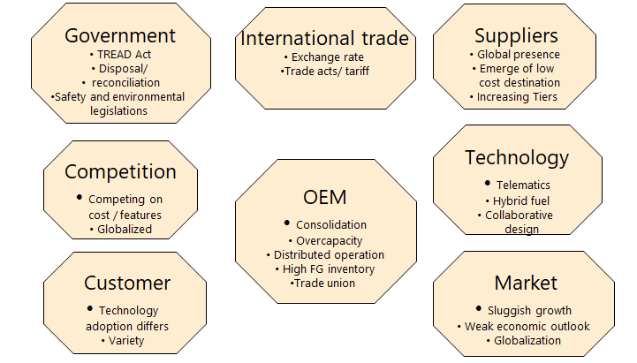
School of Electronics and Communication Engineering
Market Drivers for Auto Industry

Slide 24
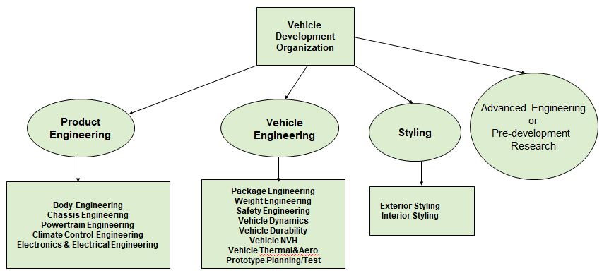
Vehicle Development Organization
School of Electronics and Communication Engineering

Slide 25
School of Electronics and Communication Engineering
Evolution of Automotive Electronics

Slide 26
School of Electronics and Communication Engineering
Evolution of Automotive Electronics
The dawn of automotive electronics came in the early 1970s, when the only electronics in a car were the radio, the alternator (diodes) and the voltage regulator that controlled the alternator.
The last 30 years have seen rapid technological innovations in automotive electronics, driven primarily by advancement in semiconductors and related software that controls the systems
1970’s: Introduction of electronics for engine controls
1980’s: Anti-lock braking introduced
Early 1990’s: Airbags become standard
Late 1990’s: Rapid expansion of body electronics – seat motors (body computers), instrument panel lighting, auto locking systems and keyless entry
Early 2000’s to date: infotainment, including sophisticated audio and video; signals sent via satellite (such as the OnStar System); GPS and mapping capabilities; satellite radio
Late 2000’s : Steer-by-wire, wireless connectivity
Trends 2020 – Connected Cars and Autonomous vehicles

Slide 27
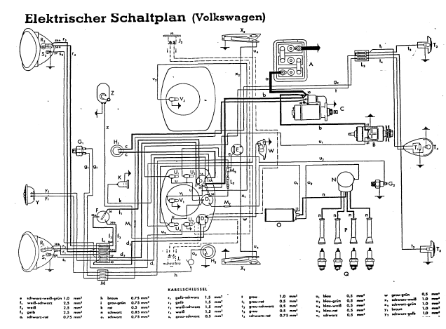
School of Electronics and Communication Engineering
Where are we coming from ?
Earlier Systems were more of Auto Electrical Systems than Electronics.

Slide 28
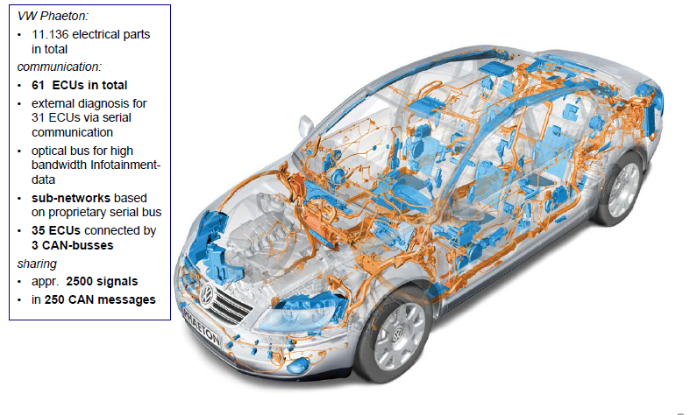
School of Electronics and Communication Engineering
Automotive Electronics Today…

Slide 29
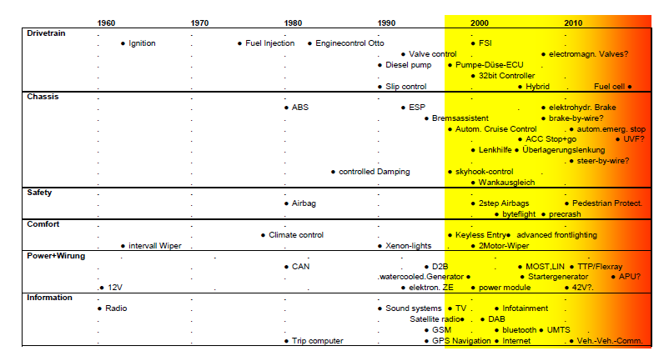
School of Electronics and Communication Engineering
Journey of Automotive electronics over the years

Slide 30
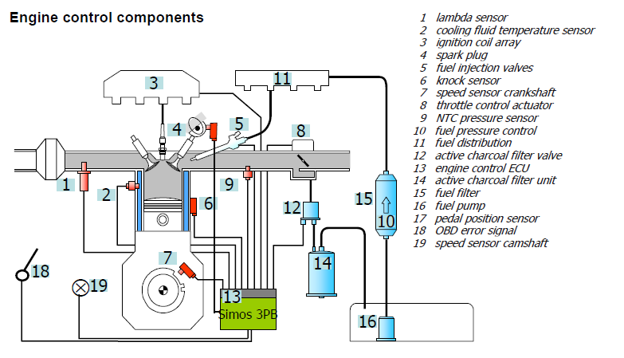
School of Electronics and Communication Engineering
Example : Engine Control

Slide 31
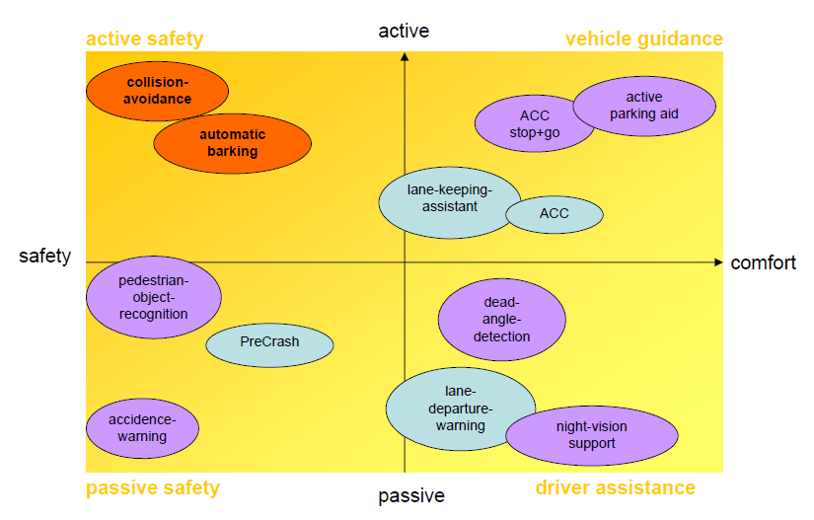
School of Electronics and Communication Engineering
Evolution of Safety Systems

Slide 32
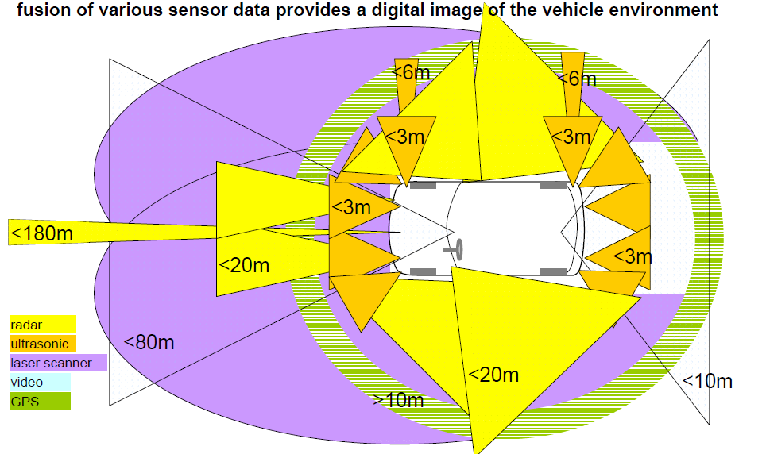
School of Electronics and Communication Engineering
Envisioning the Accident Avoidance Cars

Slide 33
School of Electronics and Communication Engineering
Paradigms Specific to Automotive Industry
Automotive industry is primarily mechanically minded
Electronics is a “service“ domain
High volumes
Car platforms up to 1 million units per year
Shared parts volume covering several platforms
Long product life cycle:
6…12 years
20 years including service
Long design phase compared to electronics industry:
–~4 years from concept to production
Very high quality standards
Safety requirements comparable to avionics
External access to vehicle communication only via restricted diagnosis port
Modular component families required to meet logistics requirements

Slide 34
School of Electronics and Communication Engineering
Problems and Challenges in Automotive Electronics Industry
Little standardization for automotive electronics and software existing
Availability of hardware components
–Automotive technology cycles exceeding those for semiconductor industry
–Redesign with new components requires extensive validation
Service personnel not qualified for electronics or software based systems
Embedded systems with mostly hard real-time requirements
–Drive train -> order of 100μs
–Chassis -> order of ms
–Body-> order of 10..100ms

Slide 35
School of Electronics and Communication Engineering
Electrical and Electronics Systems Development Process
Conventional vehicle development was mainly about designing and testing mechanical and electro-mechanical components.
Over the last decades, cars have become complex systems of E/E systems (Electrical and Electronic systems), and electronics and software development have been integrated into automotive development processes

Slide 36
School of Electronics and Communication Engineering
What happened?
Cars have up to 2500 software controlled functions, representing 10 million lines of software code
These functions are realized by up to 80 ECUs (electronic control units) that communicate via up to 5 different types of system busses
Up to 40% of a vehicles’ costs are determined by electronics and software
90% of all innovations are enabled by electronics and software
50–70% of the development costs for an ECU are related to software

Slide 37
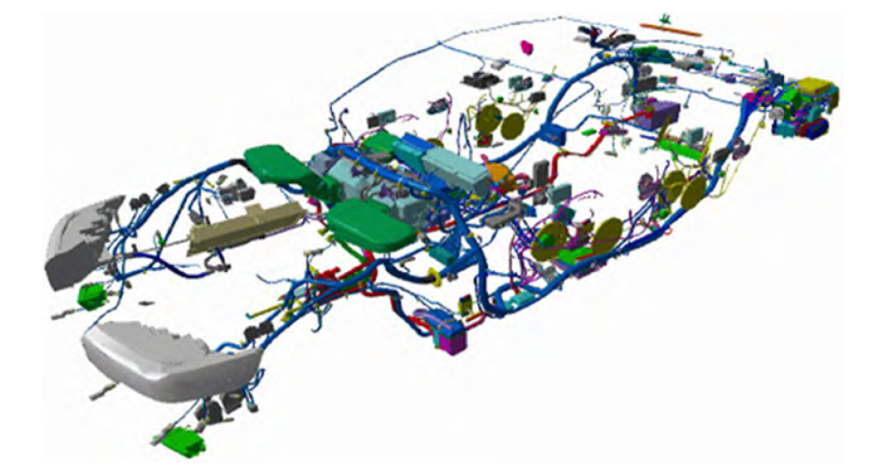
School of Electronics and Communication Engineering
Complexity of Electrical & Electronic System (Ex BMW Series -7)

Slide 38
School of Electronics and Communication Engineering
Vehicle Domains
Infotainment: Functions for information, entertainment and communication - instrument panel, audio system, antenna tuner, video module, navigation system, telephone etc.), including the central HMI (Human Machine Interface)
Body electronics: Central vehicle functions such as access management systems and anti-theft devices actuation of windows, tailgates, seats, and wipers, or cabin air management
Chassis and driver assistance: Functions enabling safe vehicle dynamics, such as ABS
Powertrain: All functions controlling the generation of driving power and its conversion into propulsion: Digital engine control, gear control, fuel pump, onboard diagnostics
Safety: Functions for collision detection and injury mitigation such as seat belt pre-tensioners, airbags, pyrotechnic roll-over bars etc

Slide 39
School of Electronics and Communication Engineering
Why Systems Engineering Approach
Automotive development unquestionably has its roots in traditional engineering, and the prevailing culture in development centers is dominated by “car guys”

Slide 40
School of Electronics and Communication Engineering
Classical V-Model of Development

Slide 41
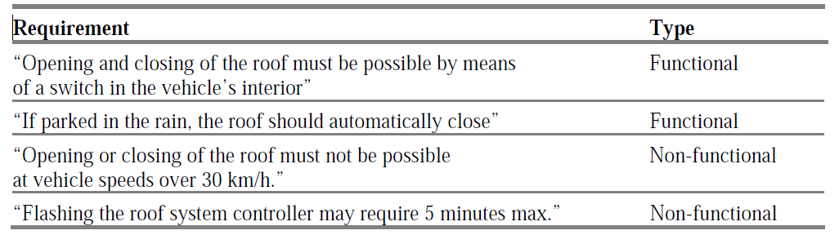
School of Electronics and Communication Engineering
Requirements Elicitation, Engineering & Analysis
Elicitation
Analysis
Stakeholder interviews
Observation of stakeholders
Testing and commenting on the usability of a system prototype
Testing of existing systems
Possible conflicts
Interfaces to the environment
Completeness
Ambiguity
Example

Slide 42
School of Electronics and Communication Engineering
Documentation and Validation
Eventually, system requirements must be specified in a formal requirements specification document that can be systematically reviewed, evaluated, and approved, and which serves as the binding basis for the following system design.
Typical forms of documentation are use cases (specifications of how the system should respond to a certain request from outside) or process specifications. IT tools that support requirements management (e.g. DOORS from Telelogic/IBM) usually use database systems that not only allow structured documentation but also attribution and linkage of requirements, and offer an interface to general office applications.

Slide 43
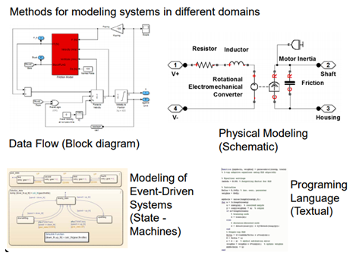
School of Electronics and Communication Engineering
LEVEL 1: Multi Domain Modeling
Product requirements
product/unit
Systemlevel
Requirement Analysis
Integration
validation
verification
Subsystem-level
MIL
(Model in loop)
integration
validation
verification
SIL
(Software in loop)
integration
validation
verification
Single part realisation level

Slide 44
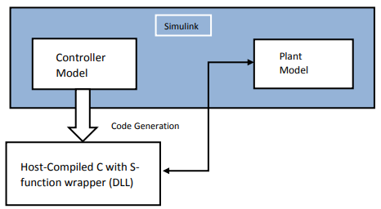
School of Electronics and Communication Engineering
LEVEL 2: Code Generation & Optimization
Product requirements
product/unit
Requirement Analysis
Integration
validation
verification
System level
Subsystem level
MIL
(Model in loop)
integration
validation
verification
SIL
(Software in loop)
integration
validation
verification
Single part realisation level
PIL
(Processor in loop)
HIL
(Hardware in loop)
Notes:
V-model according to VDI 2206 guideline
Farhan A. Salem and Ahmad A. Mahfouz, Mechatronics Subsystems' Classification, Role, Selection Criteria and Synergistic Integration in Overall System Design, American Journal of Educational Science, 2 (3), 2016,16-28
A V-model can be interpreted as a reference model that is used to propose an iterative process in design for ensuring product characteristics. In the various stages of development, modelling and model analysis covers system design to discipline-specific (i.e. to study a specific physical phenomenon) and complete system integration.

Slide 45
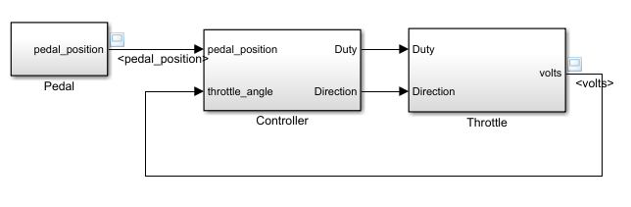
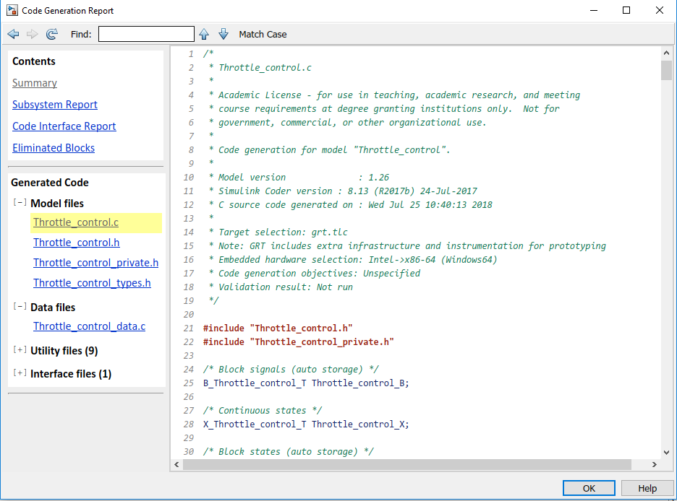
School of Electronics and Communication Engineering
Software in Loop (SIL)

Slide 46
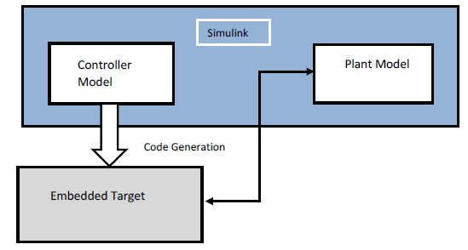
School of Electronics and Communication Engineering
LEVEL 2: On Target Prototyping
On Target Prototyping→
Cortex M3/M4, Raspbery Pi
Product requirements
product/unit
Matlab/Simulink
System level
Requirement Analysis
Integration
validation
verification
MIL
(Model in loop)
integration
validation
verification
Sub system-level
SIL
(Software in loop)
integration
validation
verification
Single part realisation level
PIL
(Processor in loop)
HIL
(Hardware in loop)
Notes:
V-model according to VDI 2206 guideline
Farhan A. Salem and Ahmad A. Mahfouz, Mechatronics Subsystems' Classification, Role, Selection Criteria and Synergistic Integration in Overall System Design, American Journal of Educational Science, 2 (3), 2016,16-28
A V-model can be interpreted as a reference model that is used to propose an iterative process in design for ensuring product characteristics. In the various stages of development, modelling and model analysis covers system design to discipline-specific (i.e. to study a specific physical phenomenon) and complete system integration.

Slide 47
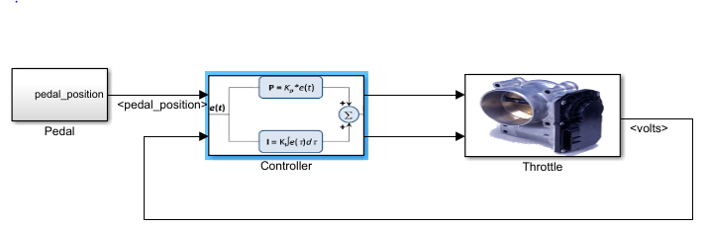
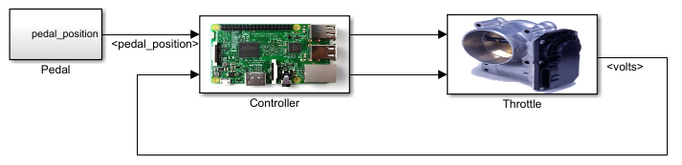
School of Electronics and Communication Engineering
Processor in Loop(PIL)
C code Generation
Target Hardware

Slide 48
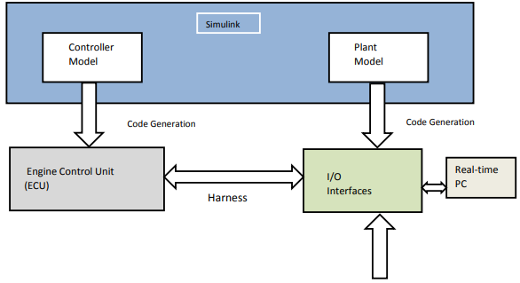
School of Electronics and Communication Engineering
LEVEL 3:ECU testing for a plant model
Controller(Engine ECU) testing for a Plant model( Raspbery Pi/ M3/M4/Speedgoat)
product requirements
product/unit
Matlab/Simulink
System level
Requirement Analysis
Integration
validation
verification
Sub system level
MIL
(Model in loop)
integration
validation
verification
SIL
(Software in loop)
integration
validation
verification
Single part realisation level
PIL
(Processor in loop)
HIL
(Hardware in loop)
Notes:
V-model according to VDI 2206 guideline
Farhan A. Salem and Ahmad A. Mahfouz, Mechatronics Subsystems' Classification, Role, Selection Criteria and Synergistic Integration in Overall System Design, American Journal of Educational Science, 2 (3), 2016,16-28
A V-model can be interpreted as a reference model that is used to propose an iterative process in design for ensuring product characteristics. In the various stages of development, modelling and model analysis covers system design to discipline-specific (i.e. to study a specific physical phenomenon) and complete system integration.

Slide 49
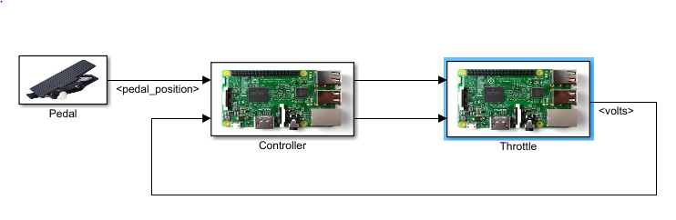
School of Electronics and Communication Engineering
Hardware in Loop (HIL)
C code Generation
Target Hardware
Target Hardware

Slide 50
School of Electronics and Communication Engineering
Verification and Validation at Every Stage
Product requirements
Product/unit
Requirement Analysis
Integration
validation
verification
System level
Verification and Validation
Subsystem level
MIL
(Model in loop)
integration
validation
verification
SIL
(Software in loop)
integration
validation
verification
Single part realisation level
PIL
(Processor in loop)
HIL
(Hardware in loop)
Notes:
V-model according to VDI 2206 guideline
Farhan A. Salem and Ahmad A. Mahfouz, Mechatronics Subsystems' Classification, Role, Selection Criteria and Synergistic Integration in Overall System Design, American Journal of Educational Science, 2 (3), 2016,16-28
A V-model can be interpreted as a reference model that is used to propose an iterative process in design for ensuring product characteristics. In the various stages of development, modelling and model analysis covers system design to discipline-specific (i.e. to study a specific physical phenomenon) and complete system integration.

Slide 51
School of Electronics and Communication Engineering
System Architecture and Design
Logical System Architecture and Technical System Architecture

Slide 52
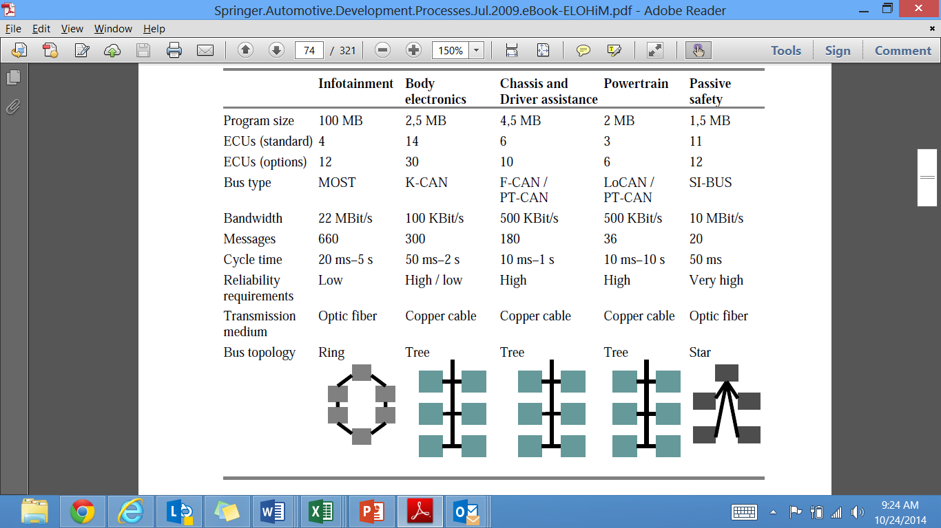
School of Electronics and Communication Engineering
Technical specifications of the E/E Domains in a luxury class vehicle (Source: BMW)

Slide 53
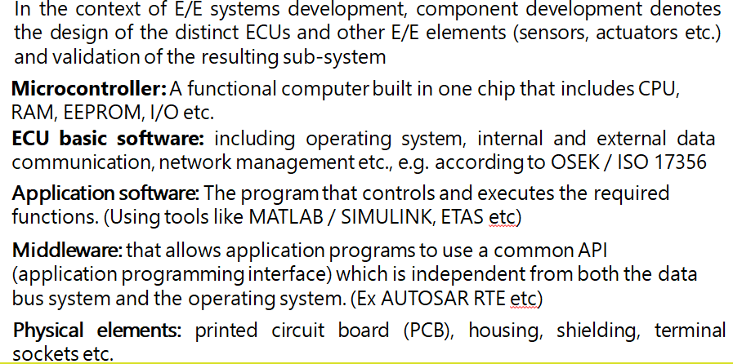
School of Electronics and Communication Engineering
Component Development Process

Slide 54
School of Electronics and Communication Engineering
Sample ECU

Slide 55
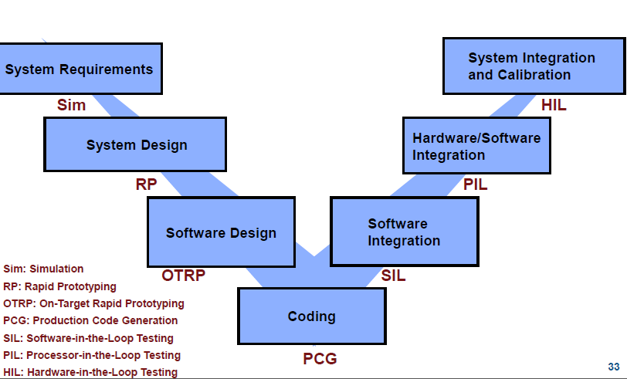
School of Electronics and Communication Engineering
Embedded Systems Software Development Process

Slide 56
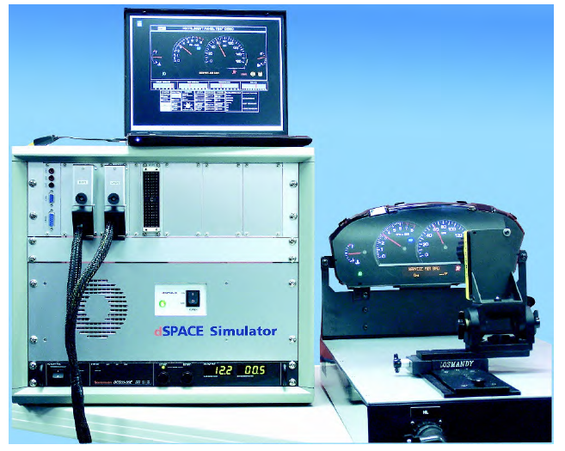
School of Electronics and Communication Engineering
MIL, SIL and HIL
IT tool kits (e.g. Matlab from The Math Works or ASCET from ETAS) offer comprehensive support for functional modelling, MIL (model-in-the-loop) and SIL (software-in-the-loop) simulation (in
which the complete hardware environment is emulated) and problem analysis down to the generation of the application software’s C code – which is compiled to assembler code
HIL test bench for an instrument panel (Source: dSPACE)

Slide 57
School of Electronics and Communication Engineering
System Integration & Validation
System integration means to physically and functionally bring together the components that have been developed by the respective (internal or external) design teams into one complete vehicle system and to ensure that this system fulfills the desired functions
Vehicle lights sub-system test bench (Source: BMW)

Slide 58
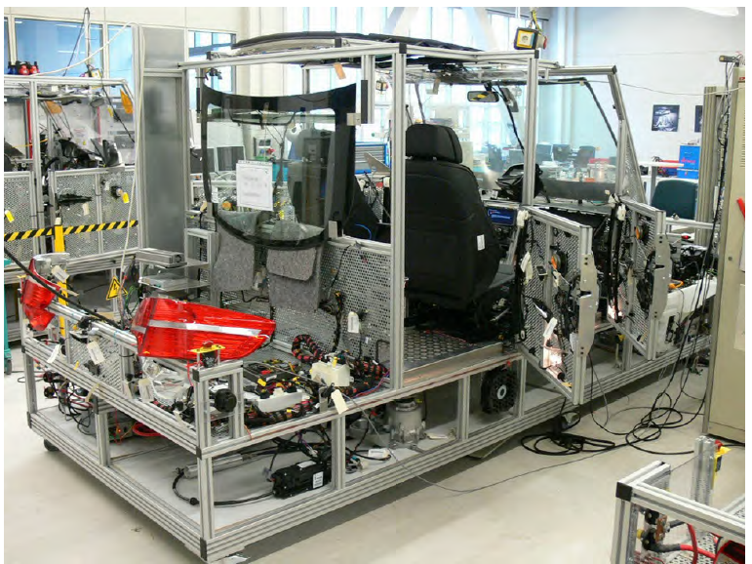
School of Electronics and Communication Engineering
Complete Vehicle Integration
A stationary lab-car includes about 80% of a complete vehicle’s E/E system. To evaluate the whole system from its internal and external customers’ view, complete vehicles from the respective build group must be investigated. These so called dynamic lab-cars are furnished with comprehensive measuring equipment

Slide 59
School of Electronics and Communication Engineering
Role of Technology and Tools in the Complete Vehicle Design and Development

Slide 60
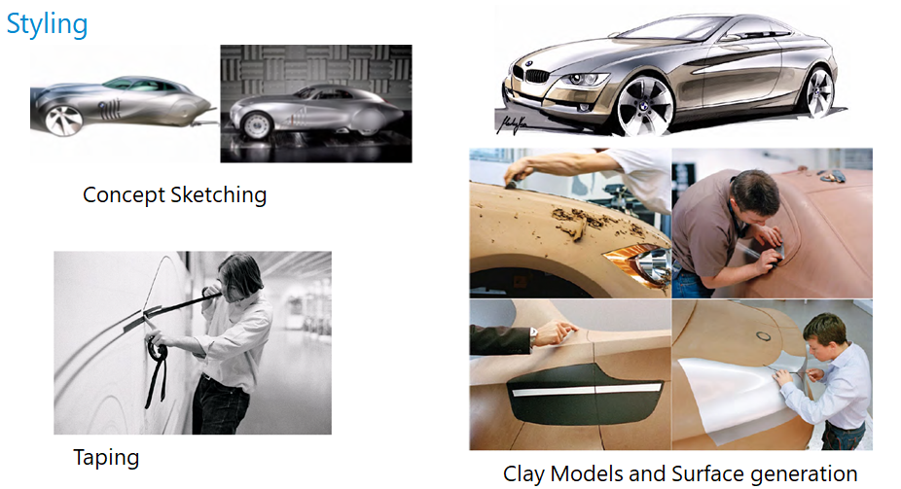
School of Electronics and Communication Engineering

Slide 61
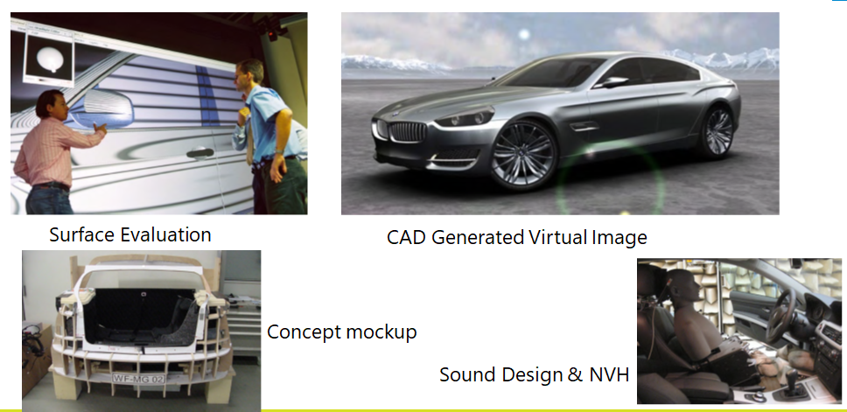
School of Electronics and Communication Engineering

Slide 62
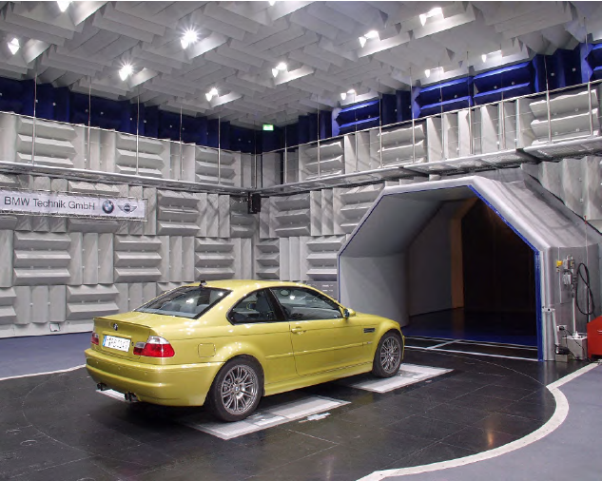
School of Electronics and Communication Engineering
Ride Comfort Test Tracks
Aero Acoustic Wind Tunnel

Slide 63
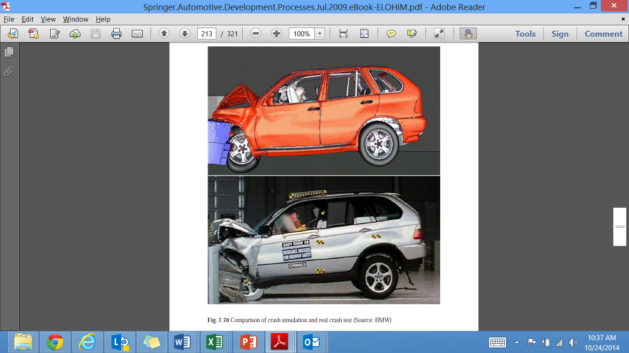
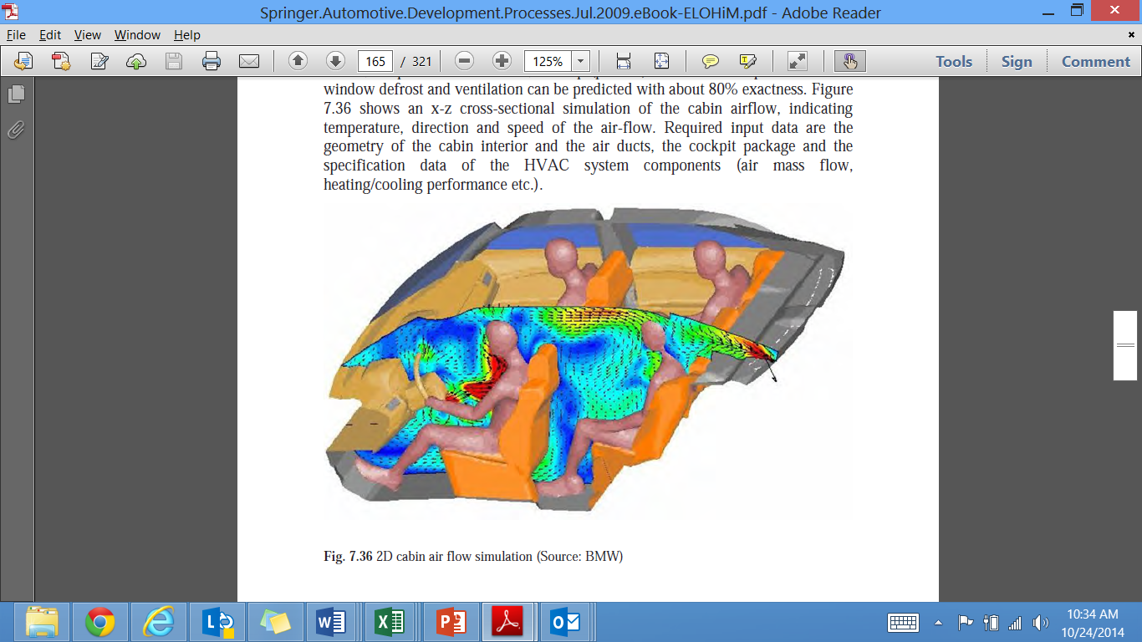
School of Electronics and Communication Engineering
Role of Non Liner FE Codes in Aerodynamics & Vehicle Crash Simulations
Cabin air flow simulation
FE Model and Crash Simulation

Slide 64
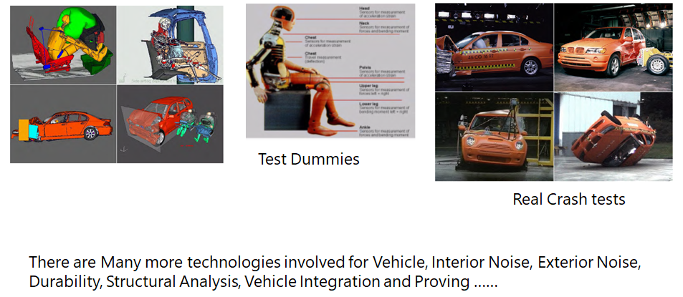
School of Electronics and Communication Engineering
Instrumented Dummies and Electronic Measurements

Slide 65
School of Electronics and Communication Engineering
Development of International Vehicle Regulations

Slide 66
School of Electronics and Communication Engineering
Regulatory Requirements
In most countries, regulatory requirements for registration approval apply to technical specifications within the following areas
Active safety (accident prevention)
Brake systems
Driver’s field of vision
Tires
Lighting
Electro-magnetic immunity
2. Passive safety (injury mitigation)
Emissions
Exhaust gas
Noise
3. Theft deterrence
4. Position of license plate, manufacturer’s plate, VIN etc.
5. Engine power
6. Weights and dimensions

Slide 67
School of Electronics and Communication Engineering
Increase in number of International Vehicle regulations

Slide 68
School of Electronics and Communication Engineering
Regulating and Certifying Authorities
In the U.S., the National Highway Traffic Safety Administration (NHTSA) has a legislative mandate to issue safety standards and regulations – the so-called Federal Motor Vehicle Safety Standards (FMVSS)
In Other countries similar bodies exist which mandate safety standards and regulate the introduction of new vehicles / import of international brands.
ARAI / ICAT / NATRIP in INDIA
ARAI: Automotive Research Association of India (https://www.araiindia.com )
ICAT : International Centre for Automotive Technology (http://icat.in/index.php)
NATRiP: National Automotive Testing and R&D Infrastructure Project (http://www.natrip.in )

Slide 69
School of Electronics and Communication Engineering
Summary
Automotive Industry has come of age from a pure play mechanical dominated industry to highly interdisciplinary industry
Automotive Electronics has been playing significant role in the Systems and Sub Systems design in Automobiles
Nearly 40% of the cost being paid to a Car is now towards its Electronics and Software
Internationalization of Auto Industry has created multilayered Tiered organizations
Virtual Simulations and use of high end test benches is dominating the design and development process
Interdisciplinary Engineers have a Significant role to play during the years to come.

Slide 70
School of Electronics and Communication Engineering
Automotive Mechanical Systems

Slide 71
School of Electronics and Communication Engineering
What are the fundamental Components of vehicle ?
Engine
Transmission unit
Braking unit
Steering unit
Differential gear
Suspension unit

Slide 72

School of Electronics and Communication Engineering
What is an Engine ?
An engine or motor is a machine designed to convert energy into useful mechanical motion .
What are the different types of Engines?
Classified Based on combustion (ignition), fuel used, cooling, application and constructions.
Based on the combustion type :
External combustion engines and 2. Internal combustion engines
Based on fuel used :
Diesel engines, 2. Petrol engines 3.CNG engines 4.LPG engines
Based on cooling system :
Air cooled engines and 2. Liquid cooled engines.
Based on applications :
Stationary engine 2. Rocket engine and 3. Automobile engine
Based on construction :
Inline engines, 2. Opposed engines, 3. Rotary engine, 4. V-engines and
5. W engines

Slide 73
School of Electronics and Communication Engineering
Diesel and Petrol engine:
Both are internal combustion Engines
Work on the same principle , ex. 4stroke, 2stroke
Diesel engines are called as CI engines
Petrol engines are called as SI engines
A variety of engine types have been produced, but one class of engine is used most:
internal combustion,
piston-type,
4-stroke/cycle,
gasoline-fueled,
spark-ignited,
liquid-cooled engine.

Slide 74

School of Electronics and Communication Engineering
The Four Strokes of a Typical Modern Gasoline-Fueled, Spark-Ignition Engine

Slide 75

School of Electronics and Communication Engineering
Intake Manifold and Fuel Metering

Slide 76

School of Electronics and Communication Engineering
Piston Connection to Crankshaft

Slide 77

School of Electronics and Communication Engineering
Valve Opening Mechanism

Slide 78
School of Electronics and Communication Engineering
Ignition System
To produce power, the gasoline engine must not only have a correct mixture of fuel and air, but also some means of initiating combustion of the mixture.
Essentially the only practical means is with an electric spark produced across the gap between a pair of electrodes of a spark plug.
The electric arc or spark provides sufficient energy to cause combustion. This phenomenon is called ignition.
Ignition system components:
Spark Plug
High-Voltage Circuit and Distribution
Spark Pulse Generation

Slide 79

School of Electronics and Communication Engineering
Spark Plug
The spark is produced by applying a high-voltage pulse of from 20kV to 40kV (1 kV is 1,000 volts) between the center electrode and ground.
The actual voltage required to start the arc varies with the size of the gap, the compression ratio, and the air–fuel ratio.
The gap may be 0.025 inch (0.6 mm) for one engine and 0.040 inch (1mm) for another engine

Slide 80

School of Electronics and Communication Engineering
High-Voltage Circuit and Distribution

Slide 81

School of Electronics and Communication Engineering
Spark Pulse Generation
The actual generation of the high-voltage pulse is accomplished by switching the current through the primary circuit.

Slide 82
School of Electronics and Communication Engineering
Ignition Timing
Ignition occurs some time before top dead center (BTDC) during the compression stroke of the piston.
This time is measured in degrees of crankshaft rotation BTDC.
For a modern SI engine, this timing is typically 8 to 10 degrees for the basic mechanical setting with the engine running at low speed (low rpm).
This basic timing is set by the design of the mechanical coupling between the crankshaft and the distributor.
The basic timing may be adjusted slightly in many older cars by physically rotating the distributor housing, during routine maintenance.

Slide 83

School of Electronics and Communication Engineering
Breaker Point Operation

Slide 84
School of Electronics and Communication Engineering
Drive Shaft
The drive shaft is used on front engine, rear wheel drive vehicles to couple the transmission output shaft to the differential input shaft.
Flexible couplings, called universal joints, allows the rear axle housing and wheels to move up and down while the transmission remains stationary.

Slide 85

School of Electronics and Communication Engineering
Transmission system
It is a technique of providing different gear or drive ratios between the engine and drive wheels of an automotive vehicle.
Types of Transmission
Manual Transmission.
Automatic Transmission.

Slide 86



School of Electronics and Communication Engineering
How Manual Transmission works ?
Manual Transmission also know as manual gear box or standard transmission.
It generally uses a driver-operated clutch
Gear stick for changing the gear.

Slide 87






School of Electronics and Communication Engineering
First Gear
Second Gear
Third Gear
Fourth Gear
Reverse Gear
Neutral Gear

Slide 88

School of Electronics and Communication Engineering
Differential Gear
The differential serves three purposes
The right angle transfer of the rotary motion of the drive shaft to the wheels.
It allow each driven wheel to turn at a different seed.
The torque increase provided by the gear ratio.
In front wheel drive cars, the transmission, differential and drive shafts are known collectively as the transaxle assembly.

Slide 89

School of Electronics and Communication Engineering
Steering System
Its one of the major subsystem is required for operation of the car.
It provides the driver control of the path of the car over the ground.
Steering angle: The angle between the front wheel plane and the longitudinal axis of the car.
The steering angle is proportional to the rotation angle of the steering wheel.
1. Steering wheel
2. Steering column
3. Rack and pinion
4. Tie rod
5. Kingpin
Many modern cars use rack and pinion steering mechanisms
steering wheel turns the pinion gear
pinion moves the rack
Rack is a linear gear that meshes with the pinion
converting circular motion into linear

Slide 90

School of Electronics and Communication Engineering
Steering System

Slide 91

School of Electronics and Communication Engineering
Brakes
Brakes are as basic to the automobile as the engine drivetrain system. These are responsible for slowing and stopping the vehicle.
Most of the kinetic energy of the car is dissipated by the brakes during deceleration and stopping.

Slide 92


School of Electronics and Communication Engineering
Suspension System
Suspension system, is the mechanical assembly that connects each wheel to the car body.
Purpose of the suspension system is to isolate the car body from the vertical motion
Wheel assembly is connected through a movable assembly to the body
The weight of the car is supported by springs
Shock absorber (sometimes a strut), which is in effect a viscous damping device.
The mass of the car body is called the sprung mass supported by springs.
Shock Absorber Assembly

Slide 93
School of Electronics and Communication Engineering
MOTIVATION FOR ELECTRONIC ENGINE CONTROL
The first came about as a result of legislation to regulate automobile exhaust emissions under the authority of the Environmental Protection Agency (EPA).
The second was a thrust to improve the national average fuel economy by government regulation.
Automotive exhaust emission control requirements started in the United States in 1966 when the California state
Exhaust Emissions
Fuel Economy

